Slide 1


Master Thesis
Architecture Development to Replace Finite Element Methods with Deep Neural Networks
Examiners:
Prof. Dr. – Ing. Andreas Schwung & Prof. Dr. – Ing. Jens Oberrath
Advisor:
MSc. Johannes Pöppelbaum
Presented by:
Kaushal Narendra Tare
(10062903)

Slide 2
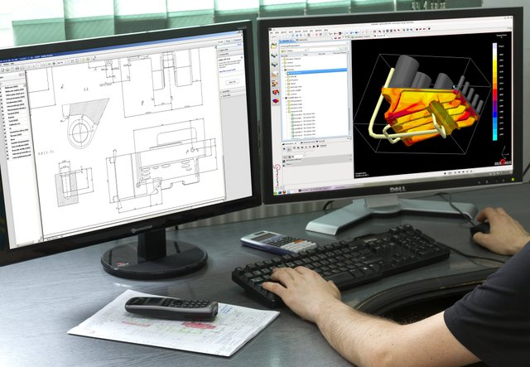
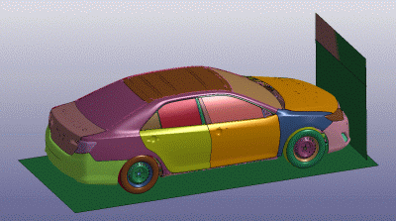
1
Introduction
Computer Aided Engineering (CAE)
The use of computer software to simulate performance in order to -
Improve product design
Assist in resolution of engineering problems

Slide 3
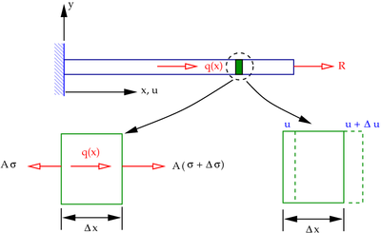
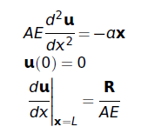
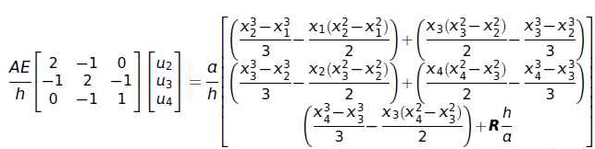
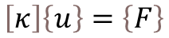
2
Finite Element Method (FEM)
FEM is a numerical method used to obtain the approximate solution in CAE
System
Most systems can be mathematically represented by differential equations
Analytical solution is easy to calculate for simple geometries and difficult for complex geometry
$$\left[κ\right]\left\{u\right\}=\left\{F\right\}$$

Slide 4
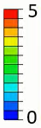

The FEA Procedure (Practical visualization)
Elements
Nodes
Meshing
Continuous System
Discrete System
Perform elementwise calculations
Obtain field solution for the entire domain
Assemble and obtain values at nodes for the entire domain

Slide 5

Limitations of FEA
Knowledge Base
Re-running the complete scenario for slightest change in the inputs (time consuming)
Data from past FE simulation runs
Highly complex scenarios are computationally expensive
Train
Machine Learning as a Solution
ML Model
ML model learns relation between inputs and outputs from historical simulation data
New/similar scenario
Predicts the new simulation scenario based on learned relations
ML model predicted output

Slide 6
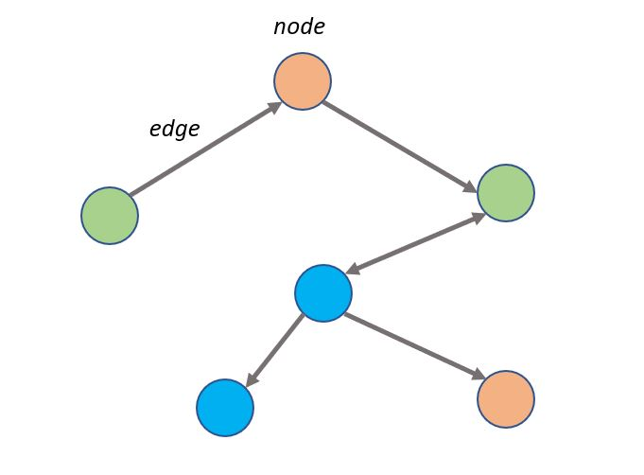
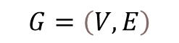
3
Deep Learning
Elements
Nodes
Graph Neural Networks
Meshing
Data structure consisting of nodes and edges
Continuous System
Discrete System
Structural analogy with discrete system in FEM
Nodes
A discrete system can be modelled as graph network
Edges
Graph Network
$$G=\left(V,E\right)$$

Slide 7
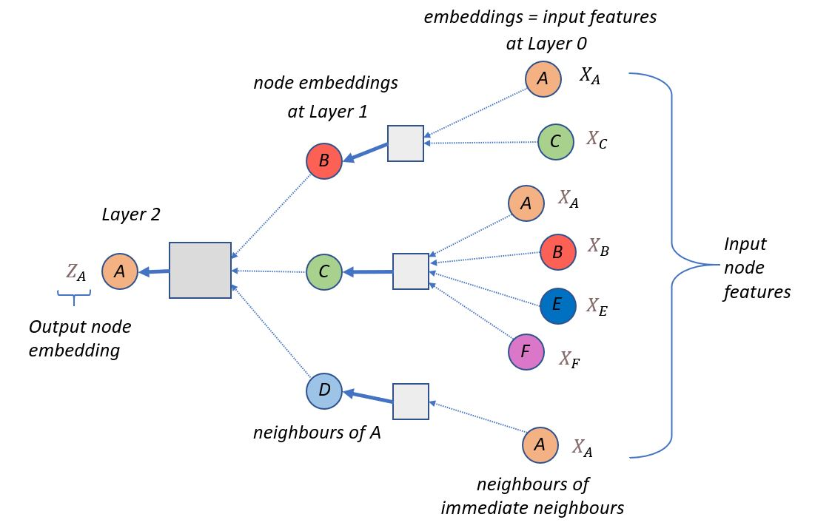
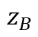
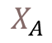
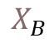
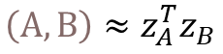
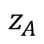
Working of GNNs
B
A
$$X_{B}$$
B
C
F
$$X_{A}$$
$$z_{B}$$
Gather locality information
D
A
E
encode nodes
Aggregate and compute the information through multiple layers
C
$$z_{A}$$
F
Obtain the final node embeddings
Embedding space
D
E
similarity
$$\left(A,B\right)≈z_{A}^{T}z_{B}$$
Computation Graph

Slide 8
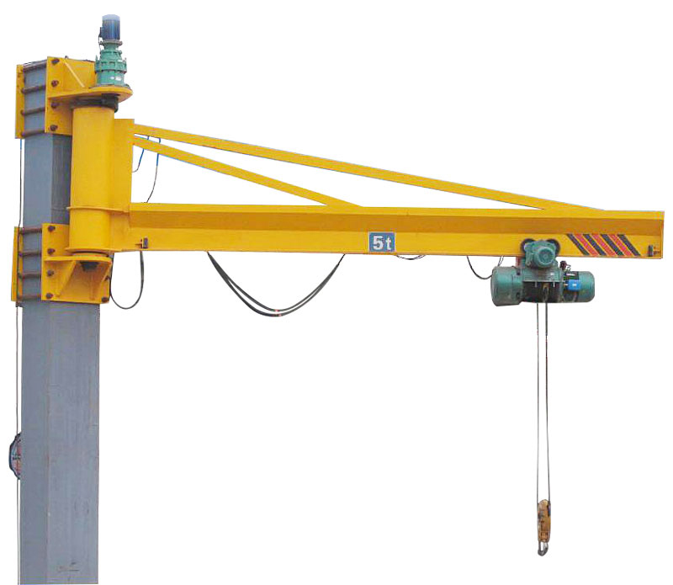
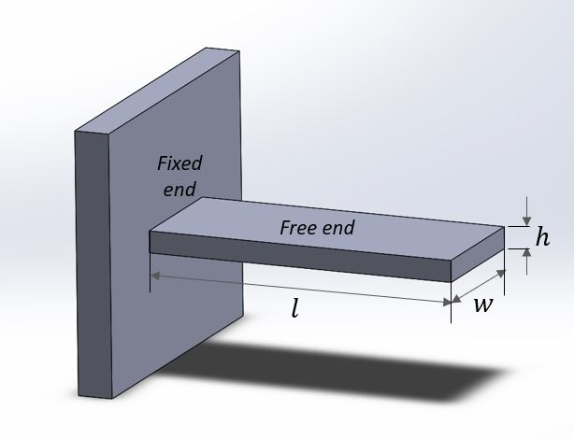
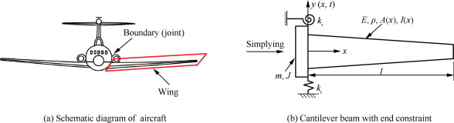
4
Case Study Scenario: Cantilever Beam
A rigid structural element supported at one end and free at other
Applications:
Aesthetic roofs
Cranes
Span of bridges
Aircraft wing

Slide 9
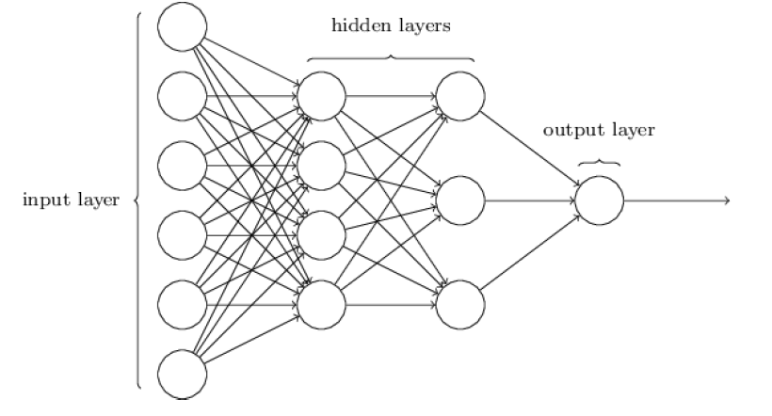
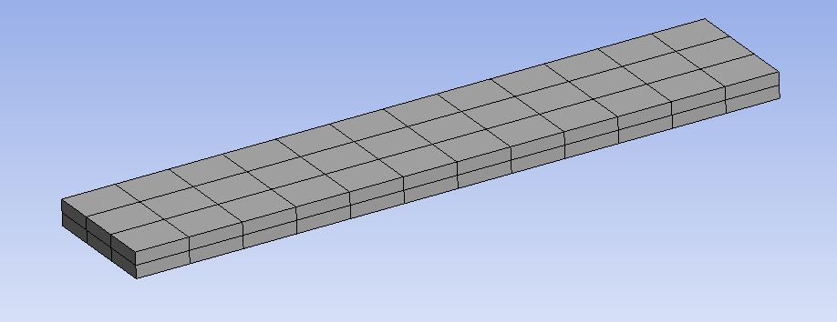
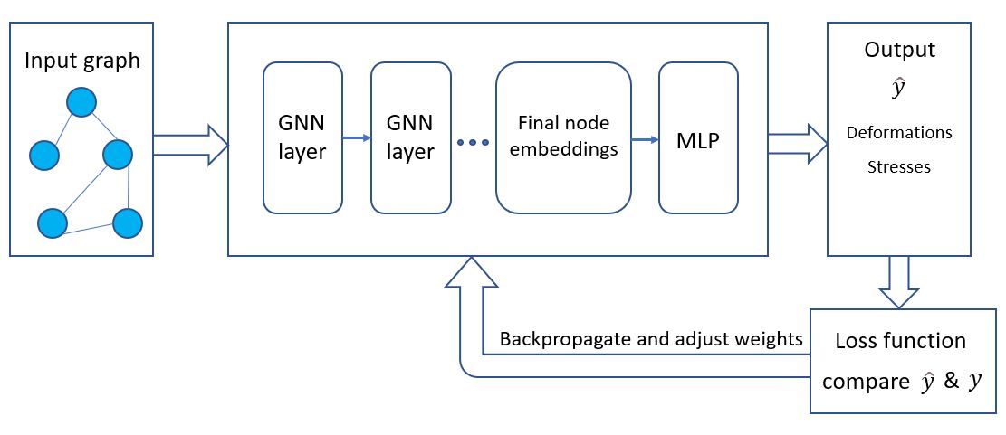
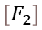
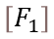
5
Building the DNN Model
Model the discrete system to GNN
Input node features as sequence of forces
Graph computations through multiple GNN layers
Pass the final node embeddings to MLP
Obtain output deformation and stress
$$\left[F_{2}\right]$$
$$\left[F_{1}\right]$$
Cantilever beam discrete system
Graph Network
DNN pipeline

Slide 10
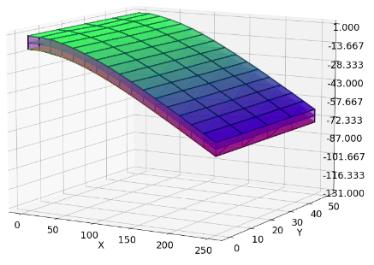
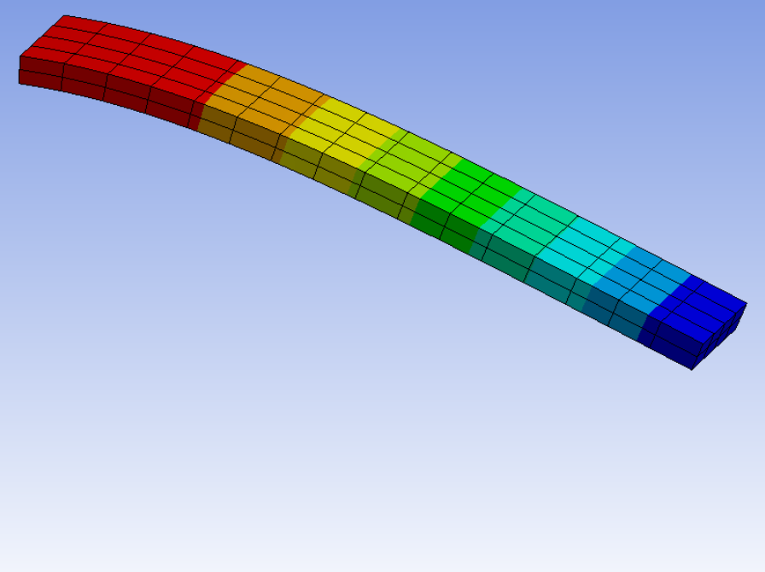
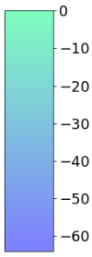
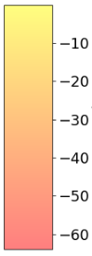
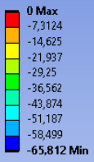
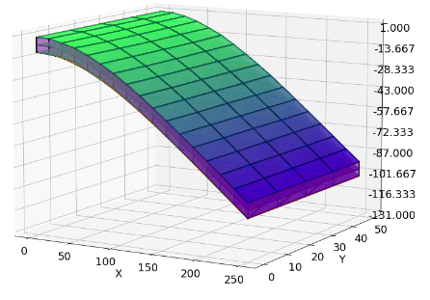
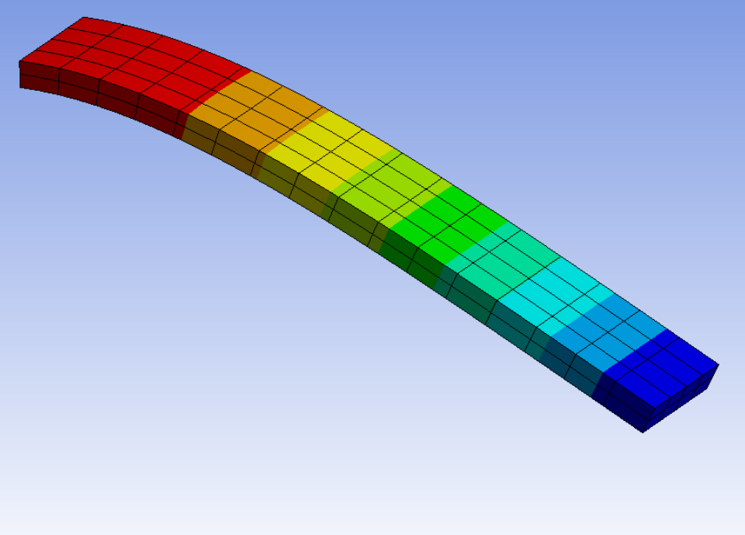
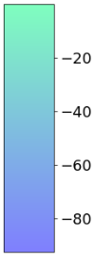
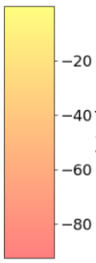
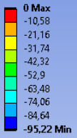
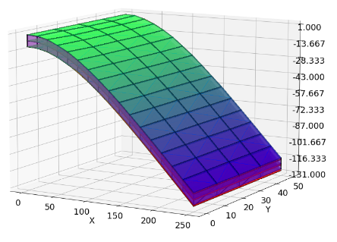
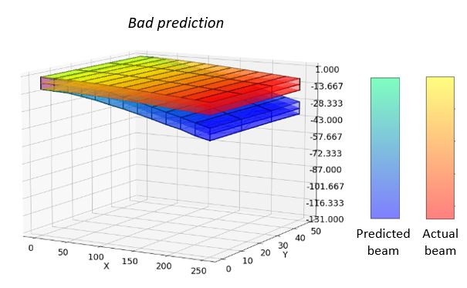
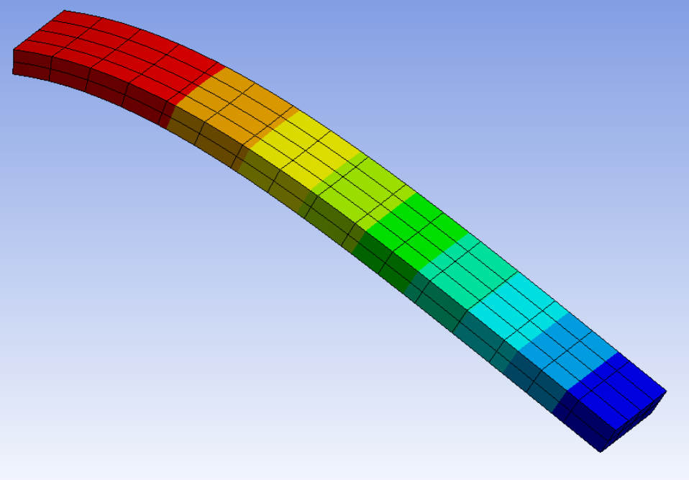
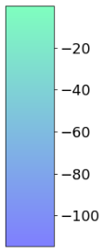
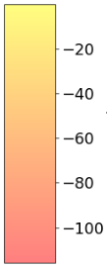
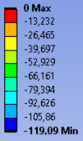
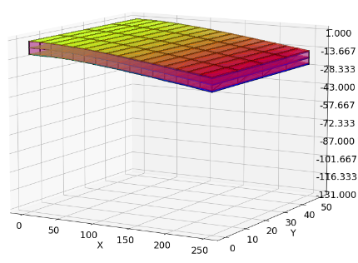
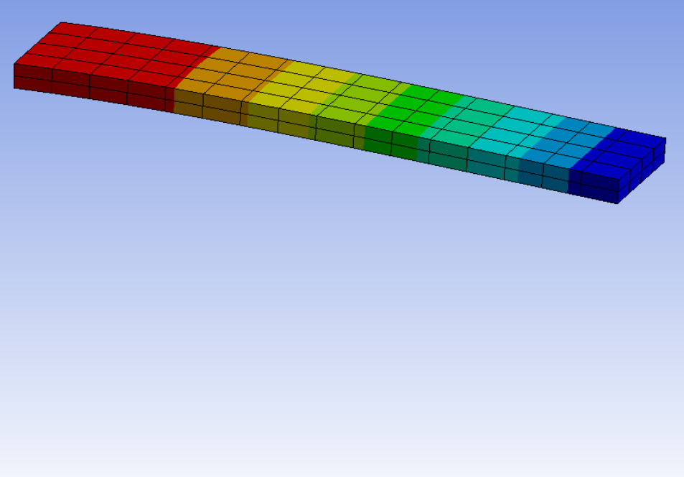
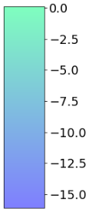
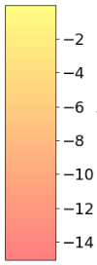
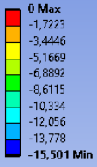
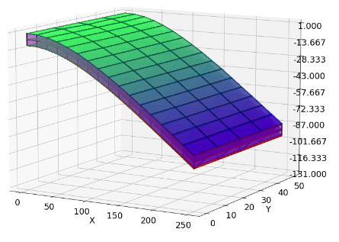
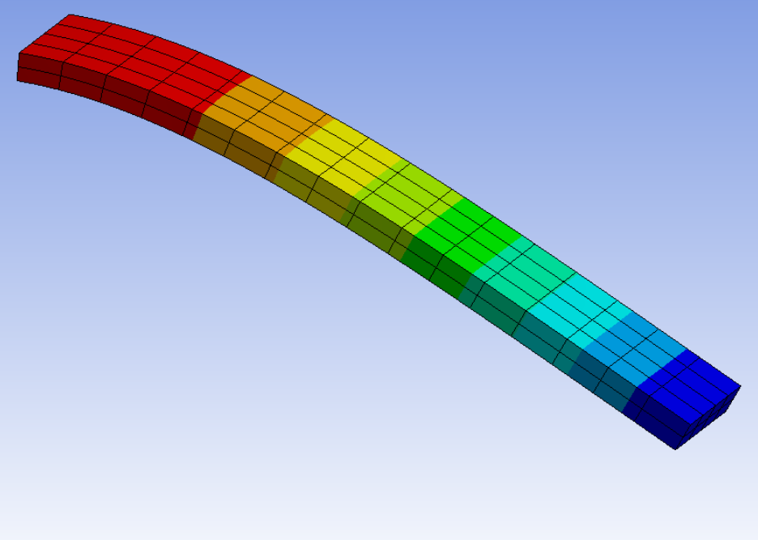
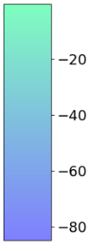
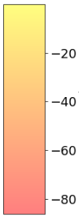
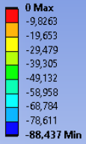
Deformation (mm) at time step 1
Experiment Results
3D Deformation Plots
Deformation (mm) at time step 4
predicted
actual
Deformation (mm) at time step 2
predicted
actual
Deformation (mm) at time step 5
predicted
actual
Deformation (mm) at time step 3
predicted
actual
Excellent deformation prediction
predicted
actual

Slide 11
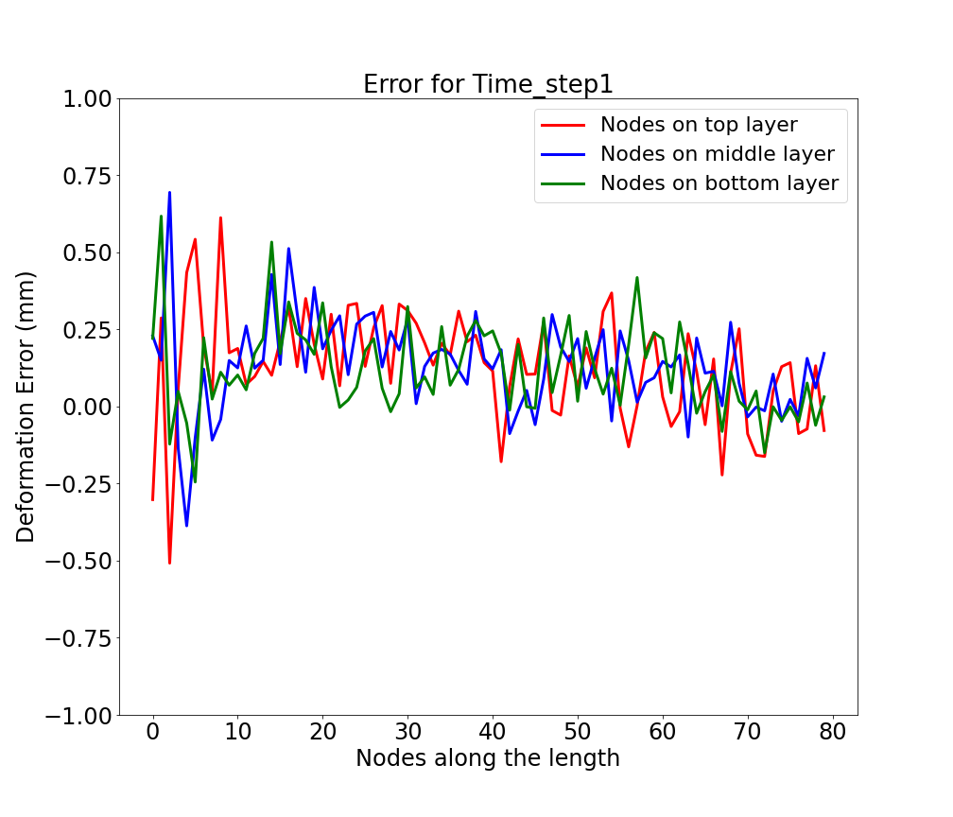









Deformation Error Visualization
Deformation error varies between -1 to +1.5 mm
Relative error is close to zero for higher deformation values at the free end

Slide 12















Stress (MPa) at time step 1
Stress Distribution Plots
Stress (MPa) at time step 4
Stress (MPa) at time step 2
Stress (MPa) at time step 5
Stress (MPa) at time step 3
The stress concentration regions are rightly predicted by the model

Slide 13










Stress Error Visualization
Stress error varies between -40 to +40 MPa
Relative stress error is close to zero for higher stress values

Slide 14
Time Analysis
FE Simulation time for 300 rows
DNN computation time for 300 rows
112.5 hrs
9 min

Slide 15
7
Conclusion
Conclusion
Model with GCN architecture replicates the FEM results obtained from the simulation software, thus capable of replacing FEM based simulation
Required computation time for DNN model is very less as compared to FE simulation software

Slide 16
Thank You!
Any questions?

